Slide 1
Hybrid Parallelism in the Hyperscale Regime
Presented by Alexander Kissinger

Slide 2
Introduction
My name is Alexander Kissinger
I am an undergraduate in Computer Engineering
This project, and all its findings, belong to SDSC and the SDSC Sandbox Project
Research P.I.: Rick Wagner (SDSC PHYS Dept.)

Slide 3
The Idea...
A hybrid-MPI Conway's Game of Life parallelized on a homemade commodity ARM (Raspberry Pi) Beowulf Cluster.

Slide 4
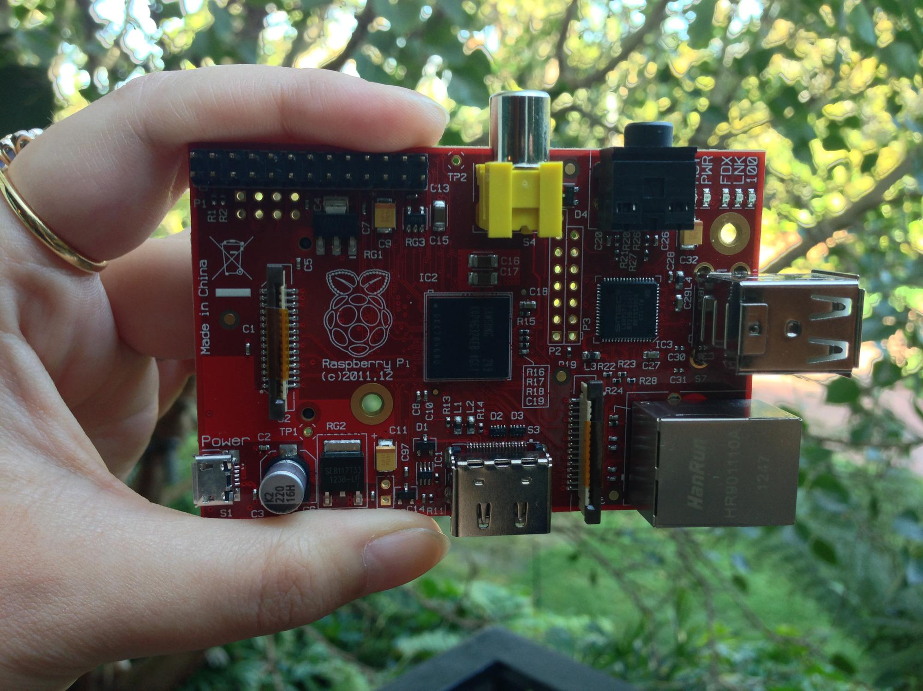
Overview of Raspberry Pi
RPi is a low powered ARM based development board
RPi Model B Rev. 2.0
700MHz ARM 1176JZF-S Core CPU
Broadcom Video IV GPU
GPU is capable of 1Gpixel/s, 1.5Gtexel/s or 24 GFLOPs
512MB SDRAM (shared with GPU)
All running 5V~1A MAX

Slide 5
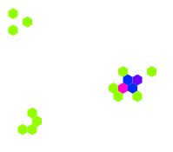
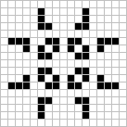
Overview of Conway's Game of Life
Conway's Game of Life (GoL) is a cellular automaton discovered by British mathematician John Horton Conway in 1970
It is a zero player game that works off of an NxM matrix where each cell is "evolves" depending on the configuration of its surrounding neighbors.

Slide 6
Hybrid-MPI vs Previous Implementations
Previous Implementations:
Serial (Python/C)
Serial with visualizations (NCurses)
Serial + GPU (Open GL, etc.)
Parallel (purely computational)
This Implementation:
Originally was going to be an NCurses+MPI implementation using Python (or C)
Evolved with the question, "how would the problem scale if it communicated boundary conditions using MPI, performed the calculations (vectorized) via GPU, and visualized it?"

Slide 7
What is Hyperscale Computing?
"Hyperscale computing is a distributed computing environment in which the volume of data and the demand for certain types of workloads can increase exponentially yet still be accommodated quickly in a cost-effective manner."

Slide 8
How Does This Tie into HC?
These hyperscale clusters have traditionally be built using high-end servers, then later to replaceable commodity clusters
As the market shifted, there were many interested in building clusters with ARM-based servers, but it lack a wide "feature set"
Now, this feature set has expanded and the idea of ARM servers are more viable
This can be seen with announcement of the ARM-based Dell Copper and HP Moonshot Calxeda

Slide 9
Why is this Implementation Interesting?
CUDA, and languages/APIs like it, require specialized hardware
Servers like the Dell Copper do not have on-board GPUs, but what if they did?
How would visualized problem sets scale on an ARM cluster?
What performance impact would incur if the GPU had to handle MPI communication through the CPU?

Slide 10
Hybrid MPI GoL
Logistics, Measurements, and Conclusion

Slide 11
How GoL is Parallelized
0
1
3
4
5
6
7
8
9

Slide 12
How GoL is Parallelized

Slide 13
Pi3d
The original idea was to use Pi3d, a Python Library, and the example implementation of GoL that ran on that library and parallelize that.
I soon found out that Pi3d was simply a sandboxed front-end to OpenGL ES, but thankfully had an OpenGL shader and driver for Conway's already written.
The Problem turned out to be OpenGL ES because everything was done using shaders applied to textures, and there was no matrix to access/manipulate, and therefore no slices of the array to send/receive with MPI.
The only solution was to hack OpenGL ES and make some bad/risky decisions...

Slide 14
Pi3d Shaders
There are two shaders applied: a vertex shader and a fragment shader. In order to describe how these work in detail would require understanding of the "graphics pipeline".
In short the vertex shader manipulates vertices in primitives or objects, and the fragment shader are functions applied to every pixel in a buffer.

Slide 15
Vertex Shader
precision highp float;
attribute vec3 vertex;
uniform vec3 unif[16];
varying vec2 pix_inv;
void main(void) {
pix_inv = vec2(1.0, 1.0) / (unif[15].xy + vec2(-1.0, -1.0)); // do this division once per vertex as slow per pixel
gl_Position = vec4(vertex, 1.0);
}

Slide 16
Fragment Shader
precision highp float;
uniform sampler2D tex0;
uniform vec3 unib[3];
uniform vec3 unif[16];
varying vec2 pix_inv;
void main(void) {
vec2 coord = vec2(gl_FragCoord); //pixel position
vec2 fcoord = vec2(0.0, 0.0); //to hold 0 to 1.0 image coordinates see pix_inv below
float ntot = 0.0; //total score of 3x3 grid of pixels
for (float i=-1.0; i < 2.0; i+=1.0) {
for (float j=-1.0; j < 2.0; j+=1.0) {
fcoord = (coord + vec2(i, j)) * pix_inv; // really dividing to scale 0-1 i.e. (x/w, y/h)
ntot += step(0.25,(texture2D(tex0, fcoord)).b); //add 1.0 if blue > 0.25
}
}
vec4 texc = texture2D(tex0, (coord * pix_inv)); //current value of pixel
ntot -= step(0.25, texc.b); // take away this square (centre of grid)
if (ntot == 3.0) texc = vec4(0.0, 0.0, 1.0, 1.0);
else if (ntot != 2.0) texc = vec4(smoothstep(0.0, 5.0, ntot), 1.0, 0.0, 0.0);
gl_FragColor = texc;
}

Slide 17
Hacking Pi3d's GoL
The main loop, of the original Conways.py file, was already dumping the GPU's buffer into a ctype Byte array and was using it to define a new texture every iteration
I realized that the buffer would change every iteration, and if I wanted to send other nodes segments of a singular node's matrix I would have to convert the byte array into a readable/accessible matrix, perform MPI calls on this matrix, and somehow force it back into the GPU.
This was risky because I didn't know anything about graphics rendering, and in doing this the GPU would be extremely bottlenecked by the time complexity of the CPU performing Python matrix calculations.

Slide 18
Final Method
After much heartache, I was able to parallelize the code by:
Taking the RAW Ctype Byte buffer and reading it in as RGB format into a PIL (Python Imaging Library) object
Turning the PIL into a Numpy matrix
Performing the MPI comm on slices and bits of the Numpy matrix
Reconstructing the Numpy matrix *SLOW
Writing the Numpy matrix into the ctype Byte array, overriding the last iterations information
And defining a new 2D Texture with the modified Byte array

Slide 19

Serial GPU

Slide 20
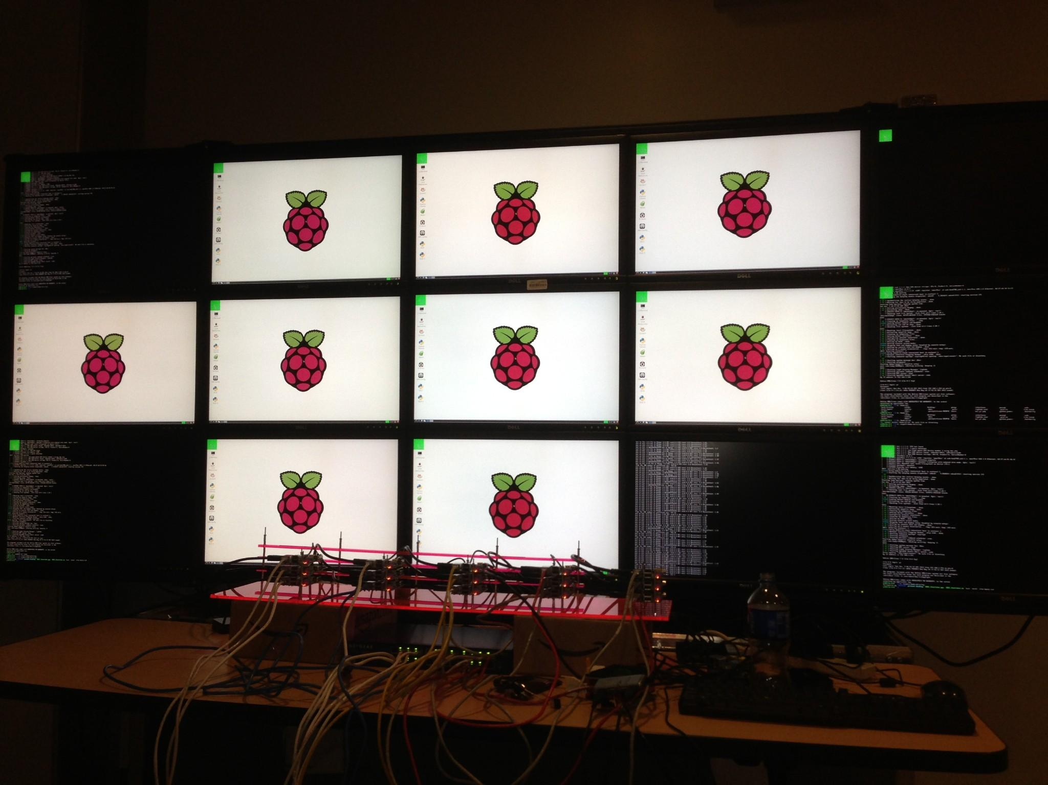
Hybrid-MPI

Slide 21
Bottlenecks
After doing a minor time analysis on MPIConway.py, I've realized that most of the computation is spent on the 3 dimensional iteration over the NumPy RGB representation of the PIL image back to a C-type byte array. Because of which, I focused on optimizing that particular segment of the code. Using Cython, I was able to isolate that iteration sequence into its own python file embedded as a function. I then "Cythoned" it into a SO "shared object" that I can import into MPIConway.py. There was an improvement, but I could tell that a large amount of cycles were being wasted.

Slide 22
Numpy Loop vs Cythonized Numpy Loop
 | 100x100 IMAGE | 500x500 IMAGE
Non-Cythonized Numpy | 1.78 seconds | 44.62 seconds
Cythonized Numpy | 1.31 seconds | 32.31 seconds
Moreover I realized that Numpy, inherently, has a major speedup over iterations on a Python Tuple. This meant that if I had initially started out using Python tuples the performance would have been worse than the numbers above. This also means that in-order to optimize the conversion sequence further would require much more research.

Slide 23
Time Measurements
Before presenting the time measurements, the following should be clarified: The Hybrid MPI GoL implementation is SIMD, currently with Fine Granularity (calling MPI after each iteration), and uses blocking point-to-point communication
The Hybrid MPI implementation will be compared against a C/C++ MPI implementation, from on Shodor, produced by Samuel Leeman-Munk
Weak Scaling will be a comparison of 15 nodes performing datasets from 300x300px-2700x2700px at 100 iterations
Strong Scaling will be a comparison of the performance of on a data set of 500x500px on 1-15 nodes at 10 iterations

Slide 24
Theoretical Analysis
Δt_{GPU}: Time for GPU to solve a single iteration
Δt_{CPU}: Time for CPU to solve a single iteration (no animation)
Δt_{MPI}: Time for send/recv boundary conditions
Δt_{CG}: Time to get and put GPU memory

Slide 25
Pure Single CPU Performance:
N*Steps
Pure GPU Performance:
N*Δt_{GPU}
CPU+MPI:
N(Δt_{CPU}+Δt_{MPI})
GPU+MPI:
N(Δt_{GPU}+Δt_{CG}+Δt_{MPI})
Question is:
N(Δt_{GPU}+Δt_{CG}+Δt_{MPI}) ≤? N(Δt_{CPU}+Δt_{MPI})
Δt_{GPU}+Δt_{CG} ≤? Δt_{CPU}

Slide 26
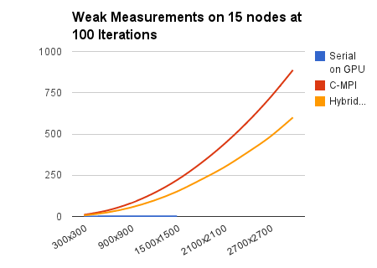
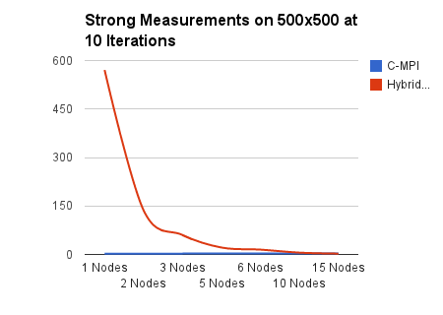
Physical Measurements
Serial GPU version broke on datasets above 1500x1500 pixels

Slide 27
Theoretical Optimizations

Slide 28
Optimize the Matrix Conversion
The matrix conversion from NumPy to a Ctype Byte array is slow and overly-complicated
Optimizations with this method (Cython) would only result in marginal performance improvements
A better way would be to figure out how to convert the initial byte array into a NumPy uint8 type matrix, without PIL, and convert that back into a datatype readable by OpenGL ES, without using a triple for loop.

Slide 29
Ghost Edges
The was an additional theory on how to optimize this process even further without just optimizing the matrix conversions. We would use send/recv "ghost" segments, a MxN-1 (M<N-1) opposed to a 1xN array, every M iterations.
In between these M iterations, the GPU would be allowed to render as quickly as it wanted. Because the serial version of Conway is capable of rendering at around 40fps, I would separate the the rendering calls from the display calls in such a fashion that the GPU would render M number of frames and enqueue that. Every 0.5 of a second, I would let the RPi paint the top image of the queue and then dequeue it. This way it would give the illusion of processing in real-time, masking away the Time Cost of matrix conversions and MPI communication.

Slide 30
News!
I asked the question, "Servers like the Dell Copper do not have on-board GPUs, but what if they did?"
Yesterday (06.02.2013), Barcelona Supercomputing Center (BSC) announced its plans to deploy an ARM prototype cluster named the Pedraforca.
It will be a hybrid using Cortex-A9, Nvidia Tesla K20 GPUs, and Mellanox QDR InfiniBand technology.
"By using InfiniBand, Pedraforca enables direct GPU-to-GPU communication through RDMA on ARM."

Slide 31
References
http://www.myraspberry-pi.org/specifications/
http://www.broadcom.com/products/Cellular/3G-Baseband-Processors/BCM28145-28155
http://www.raspberrypi.org/wp-content/uploads/2013/02/chinapiliz.jpg
http://www.wikipedia.com/
http://whatis.techtarget.com/definition/hyperscale-computing
http://www.dell.com/learn/us/en/555/campaigns/project-copper?c=us&l=en&s=biz
http://www.zdnet.com/calxeda-arm-based-hp-moonshot-later-this-year-7000013693/
http://www.shodor.org/petascale/materials/UPModules/Game_of_Life/
http://stackoverflow.com/questions/4421261/vertex-shader-vs-fragment-shader
http://insidehpc.com/2013/06/12/pedraforca-cluster-to-be-first-to-combine-arm-cpus-gpus-and-infiniband/
http://www.bsc.es/about-bsc/press/bsc-in-the-media/bsc-building-first-supercomputer-combine-arm-cpus-gpu-accelerators

